Slide 1
Chapter 2
Markup Languages:
XHTML 1.0
WEB TECHNOLOGIES
A COMPUTER SCIENCE PERSPECTIVE
JEFFREY C. JACKSON
Jackson, Web Technologies: A Computer Science Perspective, © 2007 Prentice-Hall, Inc. All rights reserved. 0-13-185603-0

Slide 2
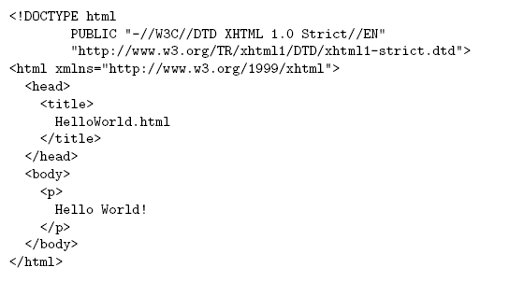
HTML “Hello World!”
Document
Type
Declaration
Document
Instance
Jackson, Web Technologies: A Computer Science Perspective, © 2007 Prentice-Hall, Inc. All rights reserved. 0-13-185603-0

Slide 3

HTML “Hello World”
Jackson, Web Technologies: A Computer Science Perspective, © 2007 Prentice-Hall, Inc. All rights reserved. 0-13-185603-0

Slide 4
HTML Tags and Elements
Any string of the form < … > is a tag
All tags in document instance of Hello World are either end tags (begin with </) or start tags (all others)
  Tags are an example of markup, that is, text treated specially by the browser
  Non-markup text is called character data and is normally displayed by the browser
String at beginning of start/end tag is an element name
Everything from start tag to matching end tag, including tags, is an element
  Content of element excludes its start and end tags
Jackson, Web Technologies: A Computer Science Perspective, © 2007 Prentice-Hall, Inc. All rights reserved. 0-13-185603-0

Slide 5
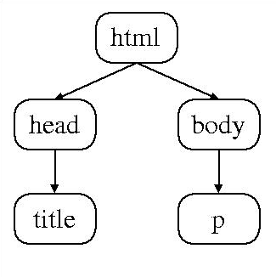
HTML Element Tree
Root
Element
Jackson, Web Technologies: A Computer Science Perspective, © 2007 Prentice-Hall, Inc. All rights reserved. 0-13-185603-0

Slide 6
HTML Root Element
Document type declaration specifies name of root element:
<!DOCTYPE html
Root of HTML document must be html
XHTML 1.0 (standard we will follow) requires that this element contain xmlns attribute specification (name/value pair)
Jackson, Web Technologies: A Computer Science Perspective, © 2007 Prentice-Hall, Inc. All rights reserved. 0-13-185603-0

Slide 7
HTML head and body Elements
The body element contains information displayed in the browser client area
The head element contains information used for other purposes by the browser:
  title (shown in title bar of browser window)
  scripts (client-side programs)
  style (display) information
  etc.
Jackson, Web Technologies: A Computer Science Perspective, © 2007 Prentice-Hall, Inc. All rights reserved. 0-13-185603-0

Slide 8
HTML History
1990: HTML invented by Tim Berners-Lee
1993: Mosaic browser adds support for images, sound, video to HTML
1994-~1997: “Browser wars” between Netscape and Microsoft, HTML defined operationally by browser support
~1997-present: Increasingly, World-Wide Web Consortium (W3C) recommendations define HTML
Jackson, Web Technologies: A Computer Science Perspective, © 2007 Prentice-Hall, Inc. All rights reserved. 0-13-185603-0

Slide 9
HTML Versions
HTML 4.01 (Dec 1999) syntax defined using Standard Generalized Markup Language (SGML)
XHTML 1.0 (Jan 2000) syntax defined using Extensible Markup Language (XML)
Primary differences:
  HTML allows some tag omissions (e.g., end tags)
  XHTML element and attribute names are lower case (HTML names are case-insensitive)
  XHTML requires that attribute values be quoted
Jackson, Web Technologies: A Computer Science Perspective, © 2007 Prentice-Hall, Inc. All rights reserved. 0-13-185603-0

Slide 10
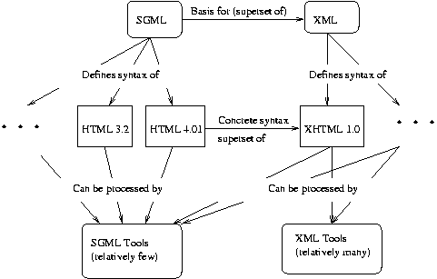
SGML and XML
SGML (Standard Generalized Markup Language)
XML (Extensible Markup Language)
Jackson, Web Technologies: A Computer Science Perspective, © 2007 Prentice-Hall, Inc. All rights reserved. 0-13-185603-0

Slide 11
HTML “Flavors”
For HTML 4.01 and XHTML 1.0, the document type declaration can be used to select one of three “flavors”:
  Strict: W3C ideal
  Transitional: Includes deprecated elements and attributes (W3C recommends use of style sheets instead)
  Frameset: Supports frames (subwindows within the client area)
Jackson, Web Technologies: A Computer Science Perspective, © 2007 Prentice-Hall, Inc. All rights reserved. 0-13-185603-0

Slide 12
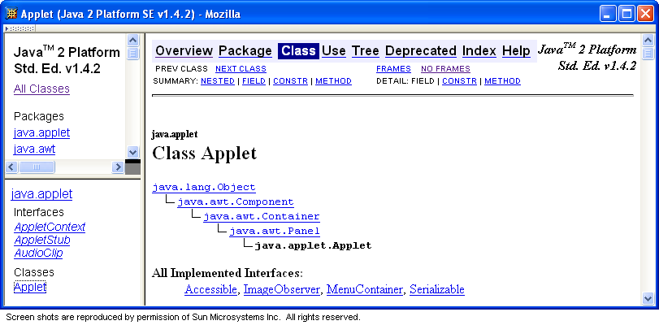
HTML Frameset
Jackson, Web Technologies: A Computer Science Perspective, © 2007 Prentice-Hall, Inc. All rights reserved. 0-13-185603-0

Slide 13
HTML Document Type Declarations
XHTML 1.0 Strict:
<!DOCTYPE html
PUBLIC "-//W3C//DTD XHTML 1.0 Strict//EN"
"http://www.w3.org/TR/xhtml1/DTD/xhtml1-strict.dtd">
XHTML 1.0 Frameset:
<!DOCTYPE html
PUBLIC "-//W3C//DTD XHTML 1.0 Frameset//EN“
"http://www.w3.org/TR/xhtml1/DTD/xhtml1-frameset.dtd">
HTML 4.01 Transitional:
<!DOCTYPE HTML
PUBLIC "-//W3C//DTD HTML 4.01 Transitional//EN“
"http://www.w3.org/TR/html4/loose.dtd">
Jackson, Web Technologies: A Computer Science Perspective, © 2007 Prentice-Hall, Inc. All rights reserved. 0-13-185603-0

Slide 14
XHTML White Space
Four white space characters: carriage return <br> HTML Tag, line feed (&amp ampersand), space, horizontal tab
Normally, character data is normalized:
  All white space is converted to space characters
  Leading and trailing spaces are trimmed
  Multiple consecutive space characters are replaced by a single space character
Jackson, Web Technologies: A Computer Science Perspective, © 2007 Prentice-Hall, Inc. All rights reserved. 0-13-185603-0

Slide 15
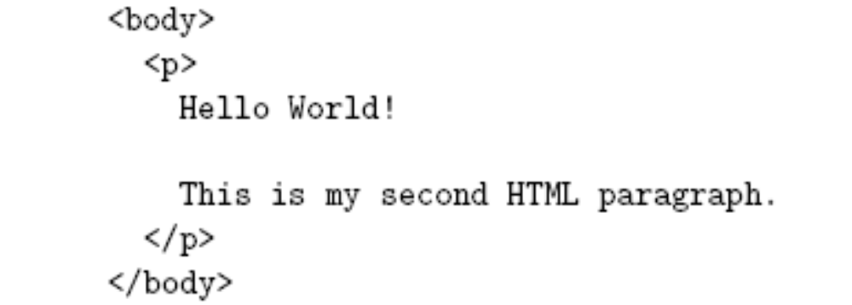
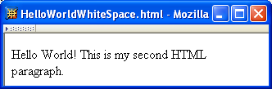
XHTML White Space
Jackson, Web Technologies: A Computer Science Perspective, © 2007 Prentice-Hall, Inc. All rights reserved. 0-13-185603-0

Slide 16
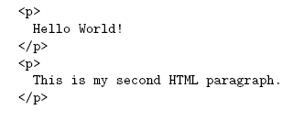
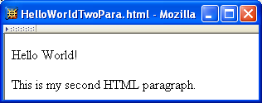
XHTML White Space
Jackson, Web Technologies: A Computer Science Perspective, © 2007 Prentice-Hall, Inc. All rights reserved. 0-13-185603-0

Slide 17
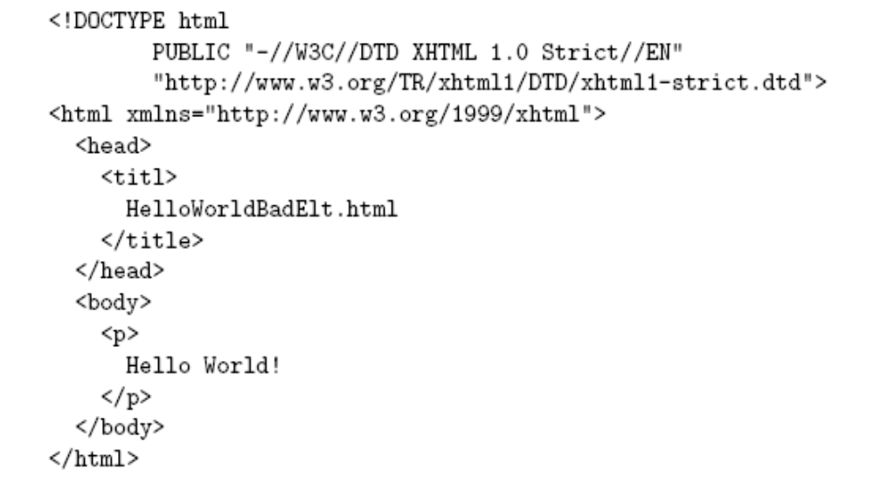
Unrecognized HTML Elements
Misspelled
element name
Jackson, Web Technologies: A Computer Science Perspective, © 2007 Prentice-Hall, Inc. All rights reserved. 0-13-185603-0

Slide 18
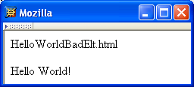
Unrecognized HTML Elements
Belongs
here
title character
data
Jackson, Web Technologies: A Computer Science Perspective, © 2007 Prentice-Hall, Inc. All rights reserved. 0-13-185603-0

Slide 19
Unrecognized HTML Elements
title character
data
Displayed
here
Jackson, Web Technologies: A Computer Science Perspective, © 2007 Prentice-Hall, Inc. All rights reserved. 0-13-185603-0

Slide 20
Unrecognized HTML Elements
Browsers ignore tags with unrecognized element names, attribute specifications with unrecognized attribute names
  Allows evolution of HTML while older browsers are still in use
Implication: an HTML document may have errors even if it displays properly
Should use an HTML validator to check syntax
Jackson, Web Technologies: A Computer Science Perspective, © 2007 Prentice-Hall, Inc. All rights reserved. 0-13-185603-0

Slide 21
HTML References
Since < marks the beginning of a tag, how do you include a < in an HTML document?
Use markup known as a reference
Two types:
  Character reference specifies a character by its Unicode code point
    For <, use &#60; or &#x3C; or &#x3c;
  Entity reference specifies a character by an HTML-defined name
    For <, use &lt;
Jackson, Web Technologies: A Computer Science Perspective, © 2007 Prentice-Hall, Inc. All rights reserved. 0-13-185603-0

Slide 22
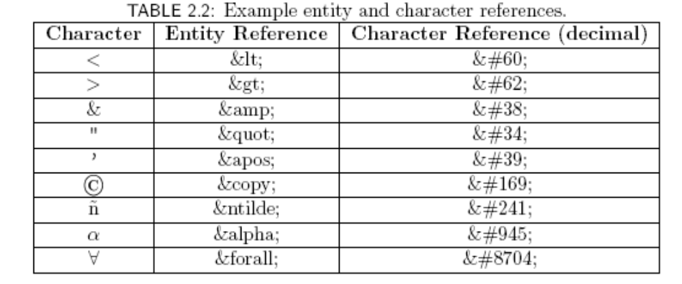
HTML References
Jackson, Web Technologies: A Computer Science Perspective, © 2007 Prentice-Hall, Inc. All rights reserved. 0-13-185603-0

Slide 23
HTML References
Since < and & begin markup, within character data or attribute values these characters must always be represented by references (normally &lt; and &amp;)
Good idea to represent > using reference (normally &gt;)
  Provides consistency with treatment of <
  Avoids accidental use of the reserved string ]]>
Jackson, Web Technologies: A Computer Science Perspective, © 2007 Prentice-Hall, Inc. All rights reserved. 0-13-185603-0

Slide 24
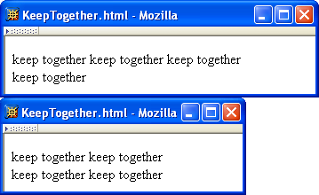
HTML References
Non-breaking space ( &nbsp; ) produces space but counts as part of a word
  Ex: keep&nbsp;together keep&nbsp;together …
Jackson, Web Technologies: A Computer Science Perspective, © 2007 Prentice-Hall, Inc. All rights reserved. 0-13-185603-0

Slide 25
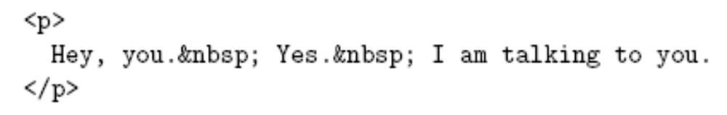
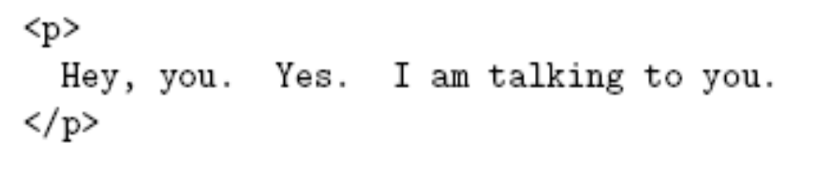
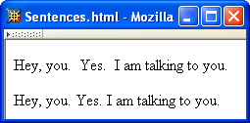
HTML References
Non-breaking space often used to create multiple spaces (not removed by normalization)
&nbsp; + space
displays as two
spaces
Jackson, Web Technologies: A Computer Science Perspective, © 2007 Prentice-Hall, Inc. All rights reserved. 0-13-185603-0

Slide 26
HTML References
Non-breaking space often used to create multiple spaces (not removed by normalization)
two spaces
display as one
Jackson, Web Technologies: A Computer Science Perspective, © 2007 Prentice-Hall, Inc. All rights reserved. 0-13-185603-0

Slide 27
XHTML Attribute Specifications
Example:
Syntax:
  Valid attribute names specified by HTML recommendation (or XML, as in xml:lang)
  Attribute values must be quoted (matching single or double quotes)
  Multiple attribute specifications are space-separated, order-independent
Jackson, Web Technologies: A Computer Science Perspective, © 2007 Prentice-Hall, Inc. All rights reserved. 0-13-185603-0

Slide 28

XHTML Attribute Values
Can contain embedded quotes or references to quotes
May be normalized by browser
  Best to normalize attribute values yourself for optimal browser compatibility
Jackson, Web Technologies: A Computer Science Perspective, © 2007 Prentice-Hall, Inc. All rights reserved. 0-13-185603-0

Slide 29
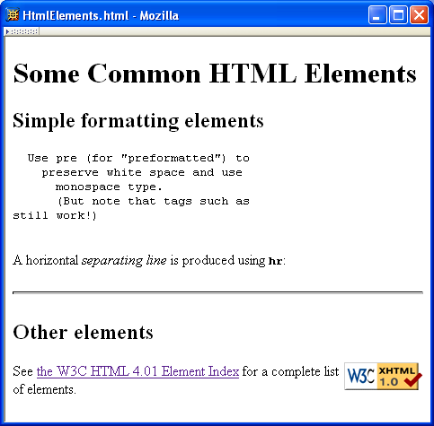
Common HTML Elements
Jackson, Web Technologies: A Computer Science Perspective, © 2007 Prentice-Hall, Inc. All rights reserved. 0-13-185603-0

Slide 30
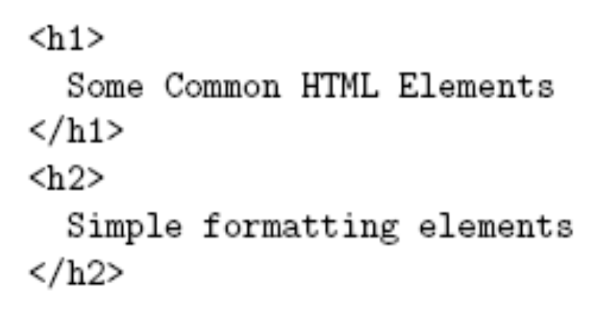
Common HTML Elements
Headings are produced using h1, h2, …, h6 elements:
Should use h1 for highest level, h2 for next highest, etc.
  Change style (next chapter) if you don’t like the “look” of a heading
Jackson, Web Technologies: A Computer Science Perspective, © 2007 Prentice-Hall, Inc. All rights reserved. 0-13-185603-0

Slide 31
Common HTML Elements
Jackson, Web Technologies: A Computer Science Perspective, © 2007 Prentice-Hall, Inc. All rights reserved. 0-13-185603-0

Slide 32
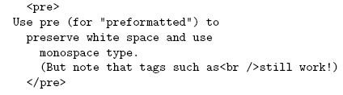
Common HTML Elements
Use pre to retain format of text and display using monospace font:
Note that any embedded markup (such as <br /> ) is still treated as markup!
Jackson, Web Technologies: A Computer Science Perspective, © 2007 Prentice-Hall, Inc. All rights reserved. 0-13-185603-0

Slide 33
Common HTML Elements
br element represents line break
br is example of an empty element, i.e., element that is not allowed to have content
XML allows two syntactic representations of empty elements
  Empty tag syntax <br /> is recommended for browser compatibility
  XML parsers also recognize syntax <br></br> (start tag followed immediately by end tag), but many browsers do not understand this for empty elements
Jackson, Web Technologies: A Computer Science Perspective, © 2007 Prentice-Hall, Inc. All rights reserved. 0-13-185603-0

Slide 34
Common HTML Elements
Jackson, Web Technologies: A Computer Science Perspective, © 2007 Prentice-Hall, Inc. All rights reserved. 0-13-185603-0

Slide 35

Common HTML Elements
Text can be formatted in various ways:
  Apply style sheet technology (next chapter) to a span element (a styleless wrapper):
  Use a phrase element that specifies semantics of text (not style directly):
  Use a font style element
    Not recommended, but frequently used
Jackson, Web Technologies: A Computer Science Perspective, © 2007 Prentice-Hall, Inc. All rights reserved. 0-13-185603-0

Slide 36
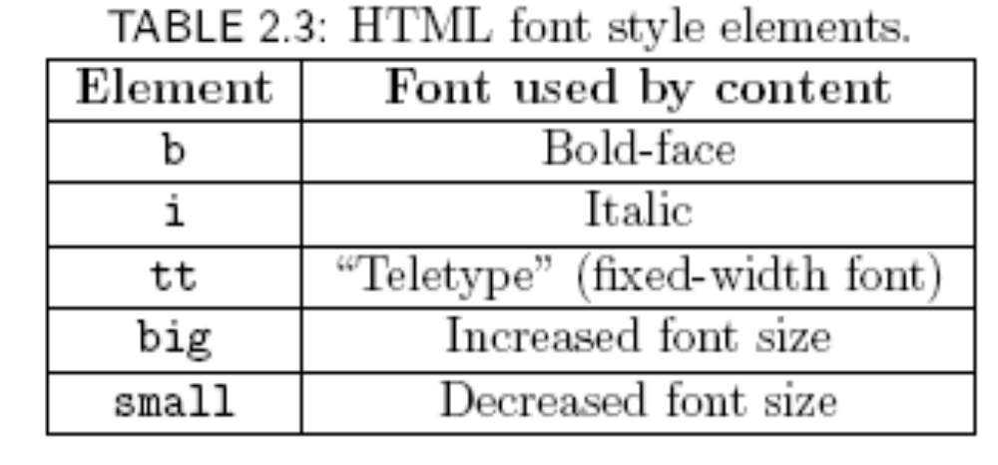
Common HTML Elements
Jackson, Web Technologies: A Computer Science Perspective, © 2007 Prentice-Hall, Inc. All rights reserved. 0-13-185603-0

Slide 37
Common HTML Elements
Jackson, Web Technologies: A Computer Science Perspective, © 2007 Prentice-Hall, Inc. All rights reserved. 0-13-185603-0

Slide 38
Common HTML Elements
Horizontal rule is produced using hr
Also an empty element
Style can be modified using style sheet technology
Jackson, Web Technologies: A Computer Science Perspective, © 2007 Prentice-Hall, Inc. All rights reserved. 0-13-185603-0

Slide 39
Common HTML Elements
Jackson, Web Technologies: A Computer Science Perspective, © 2007 Prentice-Hall, Inc. All rights reserved. 0-13-185603-0

Slide 40
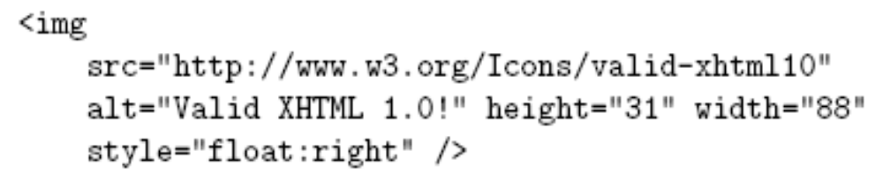
Common HTML Elements
Images can be embedded using img element
Attributes:
  src: URL of image file (required). Browser generates a GET request to this URL.
  alt: text description of image (required)
  height / width: dimensions of area that image will occupy (recommended)
Jackson, Web Technologies: A Computer Science Perspective, © 2007 Prentice-Hall, Inc. All rights reserved. 0-13-185603-0

Slide 41
Common HTML Elements
If height and width not specified for image, then browser may need to rearrange the client area after downloading the image (poor user interface for Web page)
If height and width specified are not the same as the original dimensions of image, browser will resize the image
Default units for height and width are “picture elements” (pixels)
  Can specify percentage of client area using string such as “50%”
Jackson, Web Technologies: A Computer Science Perspective, © 2007 Prentice-Hall, Inc. All rights reserved. 0-13-185603-0

Slide 42
Common HTML Elements
Monitor resolution determines pixel size
1024 elements per line
500 pixel wide line is almost
half the width of monitor
768 lines
Jackson, Web Technologies: A Computer Science Perspective, © 2007 Prentice-Hall, Inc. All rights reserved. 0-13-185603-0

Slide 43
Common HTML Elements
Monitor resolution determines pixel size
1280 elements per line
500 pixel wide line is less
than half the width of monitor
1024 lines
Jackson, Web Technologies: A Computer Science Perspective, © 2007 Prentice-Hall, Inc. All rights reserved. 0-13-185603-0

Slide 44
Common HTML Elements
Jackson, Web Technologies: A Computer Science Perspective, © 2007 Prentice-Hall, Inc. All rights reserved. 0-13-185603-0

Slide 45
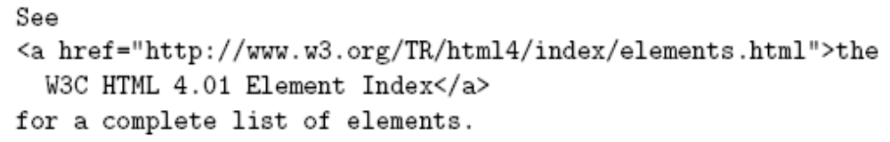
Common HTML Elements
Hyperlinks are produced by the anchor element a
Clicking on a hyperlink causes browser to issue GET request to URL specified in href attribute and render response in client area
Content of anchor element is text of hyperlink (avoid leading/trailing space in content)
Jackson, Web Technologies: A Computer Science Perspective, © 2007 Prentice-Hall, Inc. All rights reserved. 0-13-185603-0

Slide 46
Common HTML Elements
Anchors can be used as source (previous example) or destination
The fragment portion of a URL is used to reference a destination anchor
Browser scrolls so destination anchor is at (or near) top of client area
Jackson, Web Technologies: A Computer Science Perspective, © 2007 Prentice-Hall, Inc. All rights reserved. 0-13-185603-0

Slide 47

Common HTML Elements
Comments are a special form of tag
Not allowed to use -- within comment
Jackson, Web Technologies: A Computer Science Perspective, © 2007 Prentice-Hall, Inc. All rights reserved. 0-13-185603-0

Slide 48
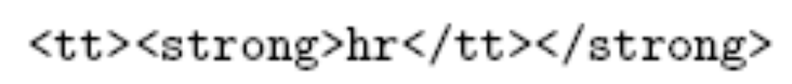
Nesting Elements
If one element is nested within another element, then the content of the inner element is also content of the outer element
XHTML requires that elements be properly nested
Jackson, Web Technologies: A Computer Science Perspective, © 2007 Prentice-Hall, Inc. All rights reserved. 0-13-185603-0

Slide 49
Nesting Elements
Most HTML elements are either block or inline
  Block: browser automatically generates line breaks before and after the element content
    Ex: p
  Inline: element content is added to the “flow”
    Ex: span, tt, strong, a
Jackson, Web Technologies: A Computer Science Perspective, © 2007 Prentice-Hall, Inc. All rights reserved. 0-13-185603-0

Slide 50
Nesting Elements
Syntactic rules of thumb:
  Children of body must be blocks
  Blocks can contain inline elements
  Inline elements cannot contain blocks
Specific rules for each version of (X)HTML are defined using SGML or XML (covered later)
Jackson, Web Technologies: A Computer Science Perspective, © 2007 Prentice-Hall, Inc. All rights reserved. 0-13-185603-0

Slide 51

Relative URL’s
Consider an <img> start tag containing attribute specification
This is an example of a relative URL: it is interpreted relative to the URL of the document that contains the img tag
  If document URL is
  http://localhost:8080/MultiFile.html
  then relative URL above represents absolute URL http://localhost:8080/valid-xhtml10.png
Jackson, Web Technologies: A Computer Science Perspective, © 2007 Prentice-Hall, Inc. All rights reserved. 0-13-185603-0

Slide 52
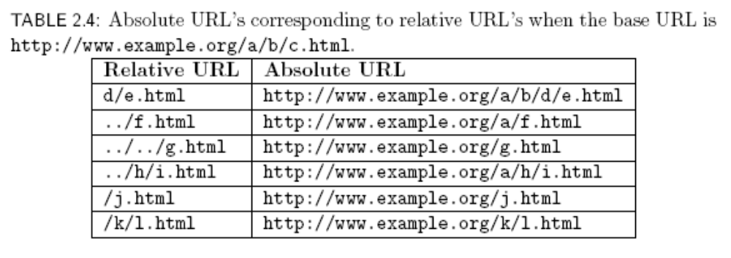
Relative URL’s
Jackson, Web Technologies: A Computer Science Perspective, © 2007 Prentice-Hall, Inc. All rights reserved. 0-13-185603-0

Slide 53

Relative URL’s
Query and fragment portions of a relative URL are appended to the resulting absolute URL
  Example: If document URL is
  http://localhost:8080/PageAnch.html
  and it contains the anchor element
  then the corresponding absolute URL is http://localhost:8080/PageAnch.html#section1
Jackson, Web Technologies: A Computer Science Perspective, © 2007 Prentice-Hall, Inc. All rights reserved. 0-13-185603-0

Slide 54
Relative URL’s
Advantages:
  Shorter than absolute URL’s
  Primary: can change the URL of a document (e.g., move document to a different directory or rename the server host) without needing to change URL’s within the document
Should use relative URL’s whenever possible
Jackson, Web Technologies: A Computer Science Perspective, © 2007 Prentice-Hall, Inc. All rights reserved. 0-13-185603-0

Slide 55
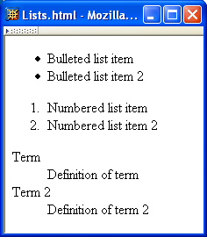
Lists
Jackson, Web Technologies: A Computer Science Perspective, © 2007 Prentice-Hall, Inc. All rights reserved. 0-13-185603-0

Slide 56
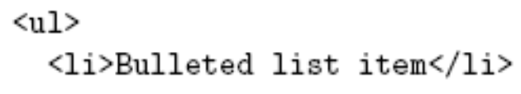
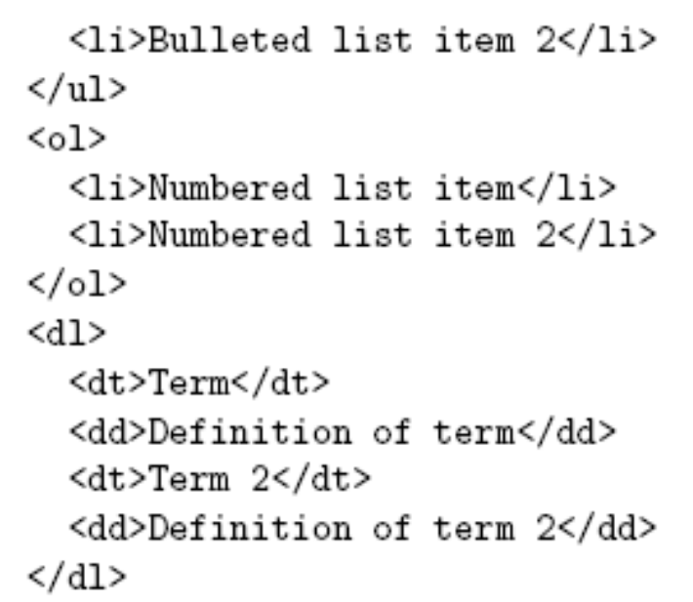
Lists
Unordered List
List Items
Ordered List
Definition List
Jackson, Web Technologies: A Computer Science Perspective, © 2007 Prentice-Hall, Inc. All rights reserved. 0-13-185603-0

Slide 57
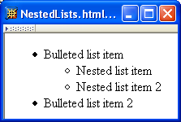
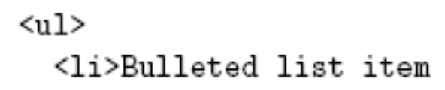
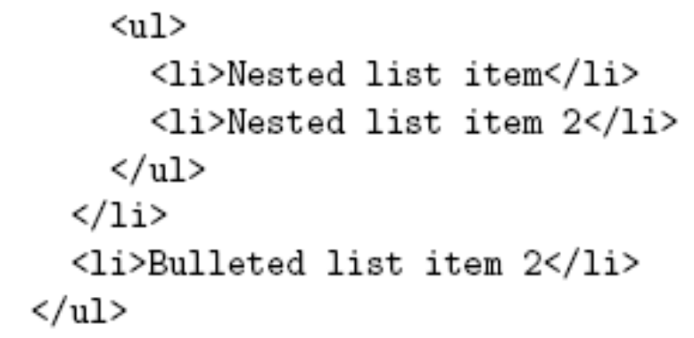
Lists
Jackson, Web Technologies: A Computer Science Perspective, © 2007 Prentice-Hall, Inc. All rights reserved. 0-13-185603-0

Slide 58
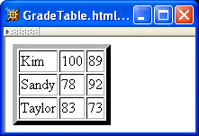
Tables
Rules
Borders
Rules
Jackson, Web Technologies: A Computer Science Perspective, © 2007 Prentice-Hall, Inc. All rights reserved. 0-13-185603-0

Slide 59
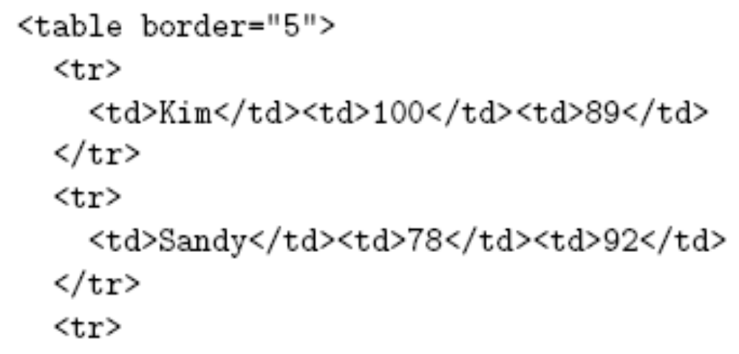
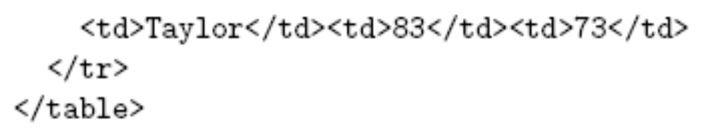
Tables
Border 5 pixels, rules 1 pixel
Table Row
Table Data
Jackson, Web Technologies: A Computer Science Perspective, © 2007 Prentice-Hall, Inc. All rights reserved. 0-13-185603-0

Slide 60
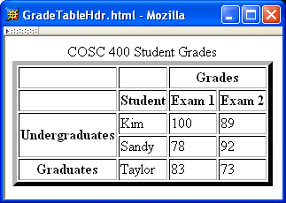
Tables
Jackson, Web Technologies: A Computer Science Perspective, © 2007 Prentice-Hall, Inc. All rights reserved. 0-13-185603-0

Slide 61
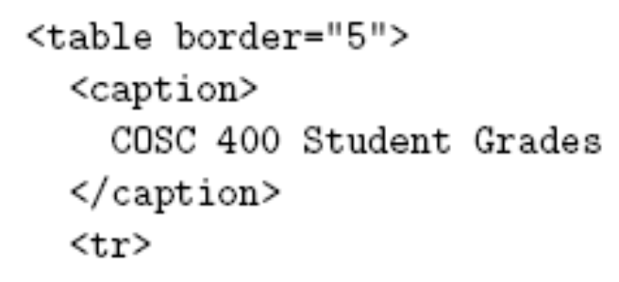
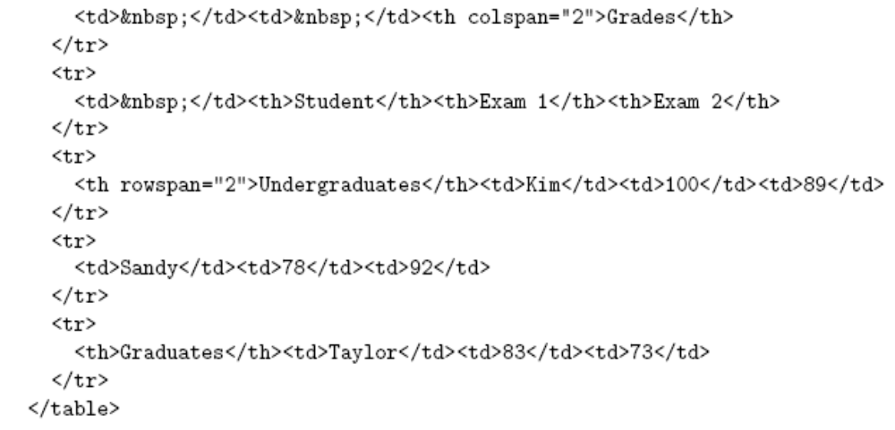
Tables
Table Header
Jackson, Web Technologies: A Computer Science Perspective, © 2007 Prentice-Hall, Inc. All rights reserved. 0-13-185603-0

Slide 62
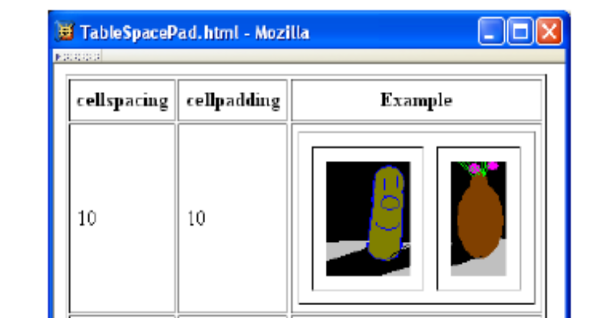
Tables
Jackson, Web Technologies: A Computer Science Perspective, © 2007 Prentice-Hall, Inc. All rights reserved. 0-13-185603-0

Slide 63
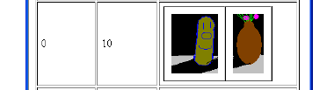
Tables
cellspacing cellpadding
Jackson, Web Technologies: A Computer Science Perspective, © 2007 Prentice-Hall, Inc. All rights reserved. 0-13-185603-0

Slide 64

Tables
cellspacing cellpadding
Jackson, Web Technologies: A Computer Science Perspective, © 2007 Prentice-Hall, Inc. All rights reserved. 0-13-185603-0

Slide 65

Tables
cellspacing cellpadding
Jackson, Web Technologies: A Computer Science Perspective, © 2007 Prentice-Hall, Inc. All rights reserved. 0-13-185603-0

Slide 66
Frames
Jackson, Web Technologies: A Computer Science Perspective, © 2007 Prentice-Hall, Inc. All rights reserved. 0-13-185603-0

Slide 67
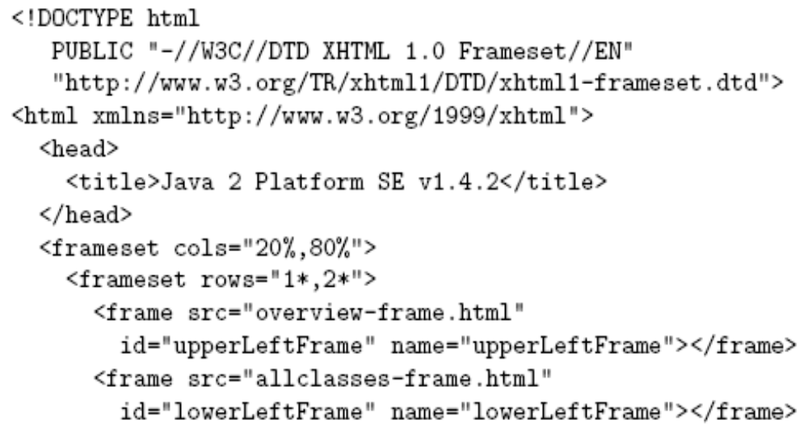
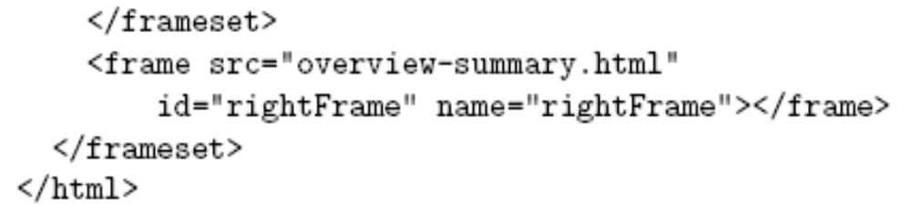
Frames
1/3,2/3 split
Jackson, Web Technologies: A Computer Science Perspective, © 2007 Prentice-Hall, Inc. All rights reserved. 0-13-185603-0

Slide 68
Frames
Hyperlink in one frame can load document in another:
Value of target attribute specification is id/name of a frame
Jackson, Web Technologies: A Computer Science Perspective, © 2007 Prentice-Hall, Inc. All rights reserved. 0-13-185603-0

Slide 69
Frames
User interface issues:
  What happens when the page is printed?
  What happens when the Back button is clicked?
  How should assistive technology “read” the page?
  How should the information be displayed on a small display?
Recommendation: avoid frames except for applications aimed at “power users”
Jackson, Web Technologies: A Computer Science Perspective, © 2007 Prentice-Hall, Inc. All rights reserved. 0-13-185603-0

Slide 70
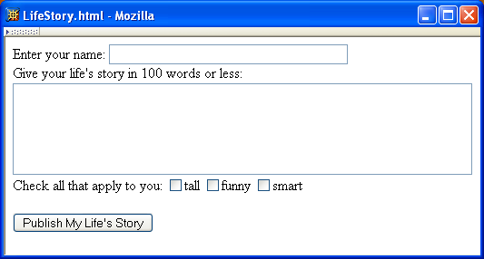
Forms
Jackson, Web Technologies: A Computer Science Perspective, © 2007 Prentice-Hall, Inc. All rights reserved. 0-13-185603-0

Slide 71
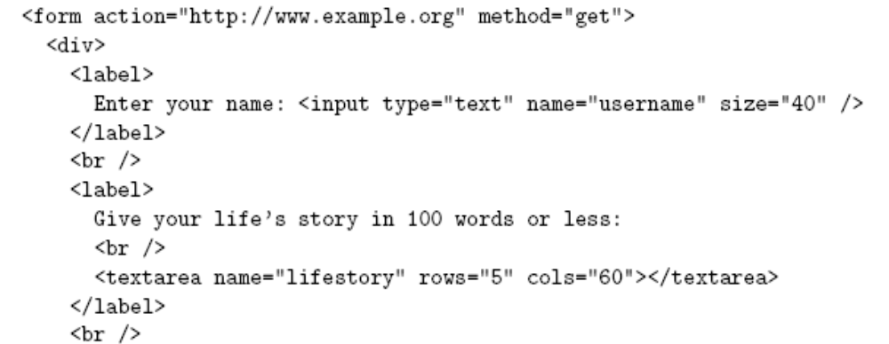
Forms
Each form is content of a form element
Jackson, Web Technologies: A Computer Science Perspective, © 2007 Prentice-Hall, Inc. All rights reserved. 0-13-185603-0

Slide 72
Forms
action specifies URL where form data is sent in an HTTP request
Jackson, Web Technologies: A Computer Science Perspective, © 2007 Prentice-Hall, Inc. All rights reserved. 0-13-185603-0

Slide 73
Forms
HTTP request method (lower case)
Jackson, Web Technologies: A Computer Science Perspective, © 2007 Prentice-Hall, Inc. All rights reserved. 0-13-185603-0

Slide 74
Forms
div is the block element analog of span (no-style block element)
Jackson, Web Technologies: A Computer Science Perspective, © 2007 Prentice-Hall, Inc. All rights reserved. 0-13-185603-0

Slide 75
Forms
Form control elements must be content of a block element
Jackson, Web Technologies: A Computer Science Perspective, © 2007 Prentice-Hall, Inc. All rights reserved. 0-13-185603-0

Slide 76
Forms
Text field control (form user-interface element)
Jackson, Web Technologies: A Computer Science Perspective, © 2007 Prentice-Hall, Inc. All rights reserved. 0-13-185603-0

Slide 77
Forms
Text field used for one-line inputs
Jackson, Web Technologies: A Computer Science Perspective, © 2007 Prentice-Hall, Inc. All rights reserved. 0-13-185603-0

Slide 78
Forms
Jackson, Web Technologies: A Computer Science Perspective, © 2007 Prentice-Hall, Inc. All rights reserved. 0-13-185603-0

Slide 79
Forms
Name associated with this control’s data in HTTP request
Jackson, Web Technologies: A Computer Science Perspective, © 2007 Prentice-Hall, Inc. All rights reserved. 0-13-185603-0

Slide 80
Forms
Width (number of characters) of text field
Jackson, Web Technologies: A Computer Science Perspective, © 2007 Prentice-Hall, Inc. All rights reserved. 0-13-185603-0

Slide 81
Forms
input is an empty element
Jackson, Web Technologies: A Computer Science Perspective, © 2007 Prentice-Hall, Inc. All rights reserved. 0-13-185603-0

Slide 82
Forms
Use label to associate text with a control
Jackson, Web Technologies: A Computer Science Perspective, © 2007 Prentice-Hall, Inc. All rights reserved. 0-13-185603-0

Slide 83
Forms
Form controls are inline elements
Jackson, Web Technologies: A Computer Science Perspective, © 2007 Prentice-Hall, Inc. All rights reserved. 0-13-185603-0

Slide 84
Forms
textarea control used for multi-line input
Jackson, Web Technologies: A Computer Science Perspective, © 2007 Prentice-Hall, Inc. All rights reserved. 0-13-185603-0

Slide 85
Forms
Height and width in characters
Jackson, Web Technologies: A Computer Science Perspective, © 2007 Prentice-Hall, Inc. All rights reserved. 0-13-185603-0

Slide 86
Forms
textarea is not an empty element; any content is displayed
Jackson, Web Technologies: A Computer Science Perspective, © 2007 Prentice-Hall, Inc. All rights reserved. 0-13-185603-0

Slide 87
Forms
Jackson, Web Technologies: A Computer Science Perspective, © 2007 Prentice-Hall, Inc. All rights reserved. 0-13-185603-0

Slide 88
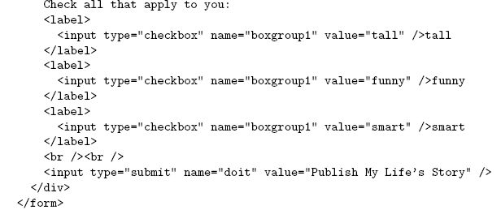
Forms
Checkbox control
Jackson, Web Technologies: A Computer Science Perspective, © 2007 Prentice-Hall, Inc. All rights reserved. 0-13-185603-0

Slide 89
Forms
Value sent in HTTP request if box is checked
Jackson, Web Technologies: A Computer Science Perspective, © 2007 Prentice-Hall, Inc. All rights reserved. 0-13-185603-0

Slide 90
Forms
Controls can share a common name
Jackson, Web Technologies: A Computer Science Perspective, © 2007 Prentice-Hall, Inc. All rights reserved. 0-13-185603-0

Slide 91
Forms
Submit button: form data sent to action URL if button is clicked
Jackson, Web Technologies: A Computer Science Perspective, © 2007 Prentice-Hall, Inc. All rights reserved. 0-13-185603-0

Slide 92
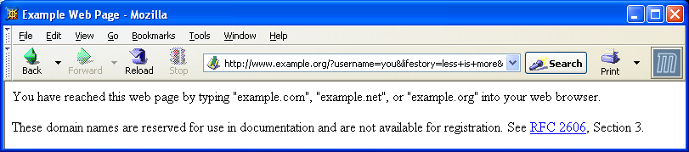
Forms
Jackson, Web Technologies: A Computer Science Perspective, © 2007 Prentice-Hall, Inc. All rights reserved. 0-13-185603-0

Slide 93
Forms
Form data (in GET request)
Jackson, Web Technologies: A Computer Science Perspective, © 2007 Prentice-Hall, Inc. All rights reserved. 0-13-185603-0

Slide 94
Forms
Displayed on button and sent to server if button clicked
Jackson, Web Technologies: A Computer Science Perspective, © 2007 Prentice-Hall, Inc. All rights reserved. 0-13-185603-0

Slide 95
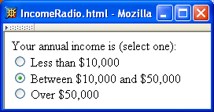
Forms
Radio buttons: at most
one can be selected at
a time.
Jackson, Web Technologies: A Computer Science Perspective, © 2007 Prentice-Hall, Inc. All rights reserved. 0-13-185603-0

Slide 96
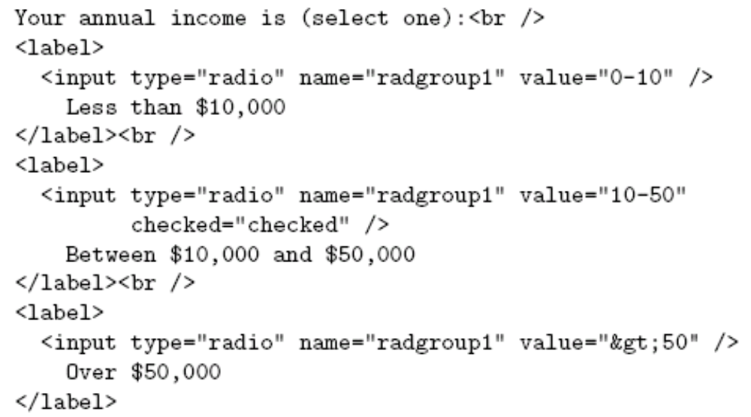
Forms
Radio button control
Jackson, Web Technologies: A Computer Science Perspective, © 2007 Prentice-Hall, Inc. All rights reserved. 0-13-185603-0

Slide 97
Forms
All radio buttons with the same name form a button set
Jackson, Web Technologies: A Computer Science Perspective, © 2007 Prentice-Hall, Inc. All rights reserved. 0-13-185603-0

Slide 98
Forms
Only one button of a set can be selected at a time
Jackson, Web Technologies: A Computer Science Perspective, © 2007 Prentice-Hall, Inc. All rights reserved. 0-13-185603-0

Slide 99
Forms
This button is initially selected
(checked attribute also applies
to check boxes)
Jackson, Web Technologies: A Computer Science Perspective, © 2007 Prentice-Hall, Inc. All rights reserved. 0-13-185603-0

Slide 100
Forms
Boolean attribute: default false,
set true by specifying name as
value
Jackson, Web Technologies: A Computer Science Perspective, © 2007 Prentice-Hall, Inc. All rights reserved. 0-13-185603-0

Slide 101
Forms
Represents string: >50
Jackson, Web Technologies: A Computer Science Perspective, © 2007 Prentice-Hall, Inc. All rights reserved. 0-13-185603-0

Slide 102
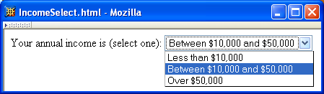
Forms
Menu
Jackson, Web Technologies: A Computer Science Perspective, © 2007 Prentice-Hall, Inc. All rights reserved. 0-13-185603-0

Slide 103
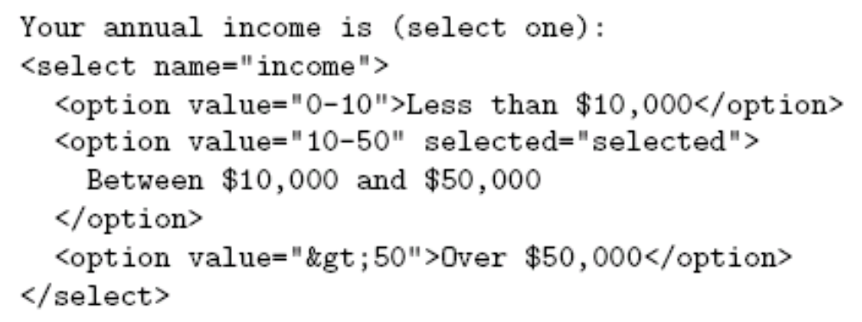
Forms
Menu control; name given once
Jackson, Web Technologies: A Computer Science Perspective, © 2007 Prentice-Hall, Inc. All rights reserved. 0-13-185603-0

Slide 104
Forms
Each menu item has its own value
Jackson, Web Technologies: A Computer Science Perspective, © 2007 Prentice-Hall, Inc. All rights reserved. 0-13-185603-0

Slide 105
Forms
Item initially displayed in menu
control
Jackson, Web Technologies: A Computer Science Perspective, © 2007 Prentice-Hall, Inc. All rights reserved. 0-13-185603-0

Slide 106
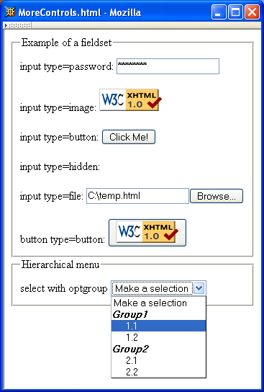
Forms
Other form controls:
  Fieldset (grouping)
  Password
  Clickable image
  Non-submit buttons
  Hidden (embed data)
  File upload
  Hierarchical menus
Jackson, Web Technologies: A Computer Science Perspective, © 2007 Prentice-Hall, Inc. All rights reserved. 0-13-185603-0

Slide 107
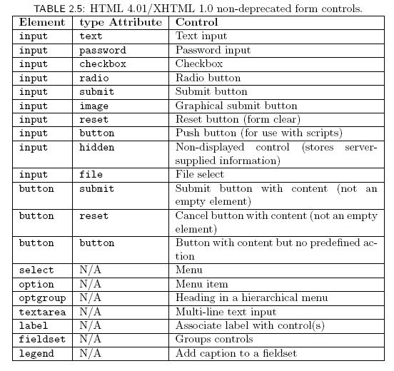
Forms
Jackson, Web Technologies: A Computer Science Perspective, © 2007 Prentice-Hall, Inc. All rights reserved. 0-13-185603-0

Slide 108
XML DTD
Recall that XML is used to define the syntax of XHTML
Set of XML files that define a language are known as the document type definition (DTD)
DTD primarily consists of declarations:
  Element type: name and content of elements
  Attribute list: attributes of an element
  Entity: define meaning of, e.g., &gt;
Jackson, Web Technologies: A Computer Science Perspective, © 2007 Prentice-Hall, Inc. All rights reserved. 0-13-185603-0

Slide 109
XML Element Type Declaration
Element type name
Jackson, Web Technologies: A Computer Science Perspective, © 2007 Prentice-Hall, Inc. All rights reserved. 0-13-185603-0

Slide 110
XML Element Type Declaration
Element type content specification (or content model)
Jackson, Web Technologies: A Computer Science Perspective, © 2007 Prentice-Hall, Inc. All rights reserved. 0-13-185603-0

Slide 111
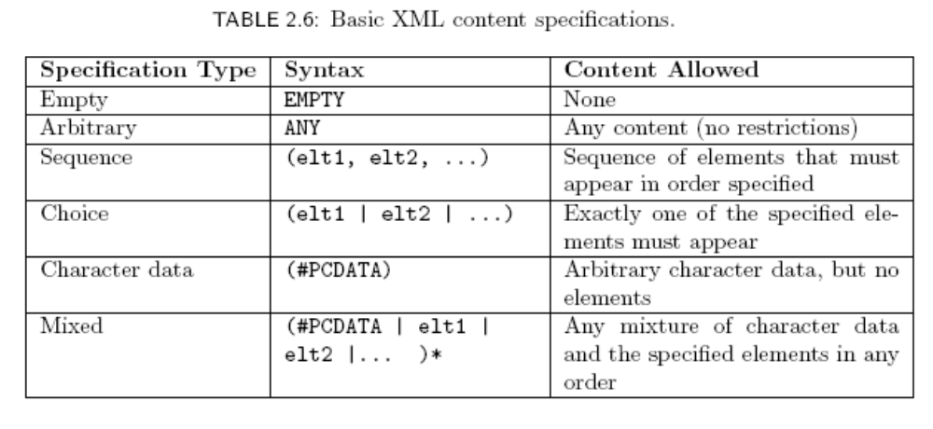
XML Element Type Declaration
Element type content specification (or content model)
Jackson, Web Technologies: A Computer Science Perspective, © 2007 Prentice-Hall, Inc. All rights reserved. 0-13-185603-0

Slide 112
XML Element Type Declaration
Element type content specification (or content model)
Jackson, Web Technologies: A Computer Science Perspective, © 2007 Prentice-Hall, Inc. All rights reserved. 0-13-185603-0

Slide 113

XML Element Type Declaration
Element type content specification (or content model)
Jackson, Web Technologies: A Computer Science Perspective, © 2007 Prentice-Hall, Inc. All rights reserved. 0-13-185603-0

Slide 114
XML Element Type Declaration
Element type content specification (or content model)
Jackson, Web Technologies: A Computer Science Perspective, © 2007 Prentice-Hall, Inc. All rights reserved. 0-13-185603-0

Slide 115
XML Element Type Declaration
Element type content specification (or content model)
Jackson, Web Technologies: A Computer Science Perspective, © 2007 Prentice-Hall, Inc. All rights reserved. 0-13-185603-0

Slide 116
XML Element Type Declaration
Element type content specification (or content model)
Jackson, Web Technologies: A Computer Science Perspective, © 2007 Prentice-Hall, Inc. All rights reserved. 0-13-185603-0

Slide 117
XML Element Type Declaration
<!ELEMENT textarea (#PCDATA)>
Element type content specification (or content model)
Jackson, Web Technologies: A Computer Science Perspective, © 2007 Prentice-Hall, Inc. All rights reserved. 0-13-185603-0

Slide 118
XML Element Type Declaration
<!ELEMENT textarea (#PCDATA)>
Element type content specification (or content model)
Jackson, Web Technologies: A Computer Science Perspective, © 2007 Prentice-Hall, Inc. All rights reserved. 0-13-185603-0

Slide 119
XML Element Type Declaration
Element type content specification (or content model)
Jackson, Web Technologies: A Computer Science Perspective, © 2007 Prentice-Hall, Inc. All rights reserved. 0-13-185603-0

Slide 120

XML Element Type Declaration
Element type content specification (or content model)
Jackson, Web Technologies: A Computer Science Perspective, © 2007 Prentice-Hall, Inc. All rights reserved. 0-13-185603-0

Slide 121
XML Element Type Declaration
Element type content specification (or content model)
Jackson, Web Technologies: A Computer Science Perspective, © 2007 Prentice-Hall, Inc. All rights reserved. 0-13-185603-0

Slide 122
XML Element Type Declaration
Child elements of table are:
Jackson, Web Technologies: A Computer Science Perspective, © 2007 Prentice-Hall, Inc. All rights reserved. 0-13-185603-0

Slide 123
XML Element Type Declaration
Child elements of table are:
  Optional caption
Jackson, Web Technologies: A Computer Science Perspective, © 2007 Prentice-Hall, Inc. All rights reserved. 0-13-185603-0

Slide 124
XML Element Type Declaration
Child elements of table are:
  Optional caption followed by
Jackson, Web Technologies: A Computer Science Perspective, © 2007 Prentice-Hall, Inc. All rights reserved. 0-13-185603-0

Slide 125
XML Element Type Declaration
Child elements of table are:
  Optional caption followed by
  Any number of col elements
Jackson, Web Technologies: A Computer Science Perspective, © 2007 Prentice-Hall, Inc. All rights reserved. 0-13-185603-0

Slide 126
XML Element Type Declaration
Child elements of table are:
  Optional caption followed by
  Any number of col elements or
Jackson, Web Technologies: A Computer Science Perspective, © 2007 Prentice-Hall, Inc. All rights reserved. 0-13-185603-0

Slide 127
XML Element Type Declaration
Child elements of table are:
  Optional caption followed by
  Any number of col elements or any number of colgroup elements
Jackson, Web Technologies: A Computer Science Perspective, © 2007 Prentice-Hall, Inc. All rights reserved. 0-13-185603-0

Slide 128
XML Element Type Declaration
Child elements of table are:
  Optional caption followed by
  Any number of col elements or any number of colgroup elements then
Jackson, Web Technologies: A Computer Science Perspective, © 2007 Prentice-Hall, Inc. All rights reserved. 0-13-185603-0

Slide 129
XML Element Type Declaration
Child elements of table are:
  Optional caption followed by
  Any number of col elements or any number of colgroup elements then
  Optional header
Jackson, Web Technologies: A Computer Science Perspective, © 2007 Prentice-Hall, Inc. All rights reserved. 0-13-185603-0

Slide 130
XML Element Type Declaration
Child elements of table are:
  Optional caption followed by
  Any number of col elements or any number of colgroup elements then
  Optional header followed by
Jackson, Web Technologies: A Computer Science Perspective, © 2007 Prentice-Hall, Inc. All rights reserved. 0-13-185603-0

Slide 131
XML Element Type Declaration
Child elements of table are:
  Optional caption followed by
  Any number of col elements or any number of colgroup elements then
  Optional header followed by optional footer
Jackson, Web Technologies: A Computer Science Perspective, © 2007 Prentice-Hall, Inc. All rights reserved. 0-13-185603-0

Slide 132
XML Element Type Declaration
Child elements of table are:
  Optional caption followed by
  Any number of col elements or any number of colgroup elements then
  Optional header followed by optional footer then
Jackson, Web Technologies: A Computer Science Perspective, © 2007 Prentice-Hall, Inc. All rights reserved. 0-13-185603-0

Slide 133
XML Element Type Declaration
Child elements of table are:
  Optional caption followed by
  Any number of col elements or any number of colgroup elements then
  Optional header followed by optional footer then
  One or more tbody elements
Jackson, Web Technologies: A Computer Science Perspective, © 2007 Prentice-Hall, Inc. All rights reserved. 0-13-185603-0

Slide 134
XML Element Type Declaration
Child elements of table are:
  Optional caption followed by
  Any number of col elements or any number of colgroup elements then
  Optional header followed by optional footer then
  One or more tbody elements or
Jackson, Web Technologies: A Computer Science Perspective, © 2007 Prentice-Hall, Inc. All rights reserved. 0-13-185603-0

Slide 135
XML Element Type Declaration
Child elements of table are:
  Optional caption followed by
  Any number of col elements or any number of colgroup elements then
  Optional header followed by optional footer then
  One or more tbody elements or one or more tr elements
Jackson, Web Technologies: A Computer Science Perspective, © 2007 Prentice-Hall, Inc. All rights reserved. 0-13-185603-0

Slide 136

XML Attribute List Declaration
Element type name
Jackson, Web Technologies: A Computer Science Perspective, © 2007 Prentice-Hall, Inc. All rights reserved. 0-13-185603-0

Slide 137
XML Attribute List Declaration
Recognized
attribute names
Jackson, Web Technologies: A Computer Science Perspective, © 2007 Prentice-Hall, Inc. All rights reserved. 0-13-185603-0

Slide 138
XML Attribute List Declaration
Attribute types
(data types allowed as attribute values)
Jackson, Web Technologies: A Computer Science Perspective, © 2007 Prentice-Hall, Inc. All rights reserved. 0-13-185603-0

Slide 139
XML Attribute List Declaration
ASCII characters: letter, digit, or . - _ :
Jackson, Web Technologies: A Computer Science Perspective, © 2007 Prentice-Hall, Inc. All rights reserved. 0-13-185603-0

Slide 140
XML Attribute List Declaration
Attribute value must be ltr or rtl
Jackson, Web Technologies: A Computer Science Perspective, © 2007 Prentice-Hall, Inc. All rights reserved. 0-13-185603-0

Slide 141
XML Attribute List Declaration
Like NMTOKEN but must begin with letter or _ :
Attribute value must be unique
Jackson, Web Technologies: A Computer Science Perspective, © 2007 Prentice-Hall, Inc. All rights reserved. 0-13-185603-0

Slide 142
XML Attribute List Declaration
Any character except XML special characters < and &
or the quote character enclosing the attribute value
Jackson, Web Technologies: A Computer Science Perspective, © 2007 Prentice-Hall, Inc. All rights reserved. 0-13-185603-0

Slide 143

XML Attribute List Declaration
Jackson, Web Technologies: A Computer Science Perspective, © 2007 Prentice-Hall, Inc. All rights reserved. 0-13-185603-0

Slide 144
XML Attribute List Declaration
Attribute default declarations
Jackson, Web Technologies: A Computer Science Perspective, © 2007 Prentice-Hall, Inc. All rights reserved. 0-13-185603-0

Slide 145

XML Attribute List Declaration
Jackson, Web Technologies: A Computer Science Perspective, © 2007 Prentice-Hall, Inc. All rights reserved. 0-13-185603-0

Slide 146

XML Entity Declaration
Entity declaration is essentially a macro
Two types of entity:
  General: referenced from HTML document using &
Entity name
Jackson, Web Technologies: A Computer Science Perspective, © 2007 Prentice-Hall, Inc. All rights reserved. 0-13-185603-0

Slide 147
XML Entity Declaration
Entity declaration is essentially a macro
Two types of entity:
  General: referenced from HTML document using &
Replacement text;
recursively replaced if it is a reference
Jackson, Web Technologies: A Computer Science Perspective, © 2007 Prentice-Hall, Inc. All rights reserved. 0-13-185603-0

Slide 148

XML Entity Declaration
Entity declaration is essentially a macro
Two types of entity:
  General: referenced from HTML document using &
  Parameter: reference from DTD using %
Jackson, Web Technologies: A Computer Science Perspective, © 2007 Prentice-Hall, Inc. All rights reserved. 0-13-185603-0

Slide 149
XML Entity Declaration
Entity declaration is essentially a macro
Two types of entity:
  General: referenced from HTML document using &
  Parameter: reference from DTD using %
Jackson, Web Technologies: A Computer Science Perspective, © 2007 Prentice-Hall, Inc. All rights reserved. 0-13-185603-0

Slide 150

DTD Files
DTD document contains element type, attribute list, and entity declarations
May also contain declaration of external entities: identifiers for secondary DTD documents
System Identifier: URL for primary DTD document
Jackson, Web Technologies: A Computer Science Perspective, © 2007 Prentice-Hall, Inc. All rights reserved. 0-13-185603-0

Slide 151

DTD Files
External entity name
Jackson, Web Technologies: A Computer Science Perspective, © 2007 Prentice-Hall, Inc. All rights reserved. 0-13-185603-0

Slide 152
DTD Files
System identifier (relative URL)
Jackson, Web Technologies: A Computer Science Perspective, © 2007 Prentice-Hall, Inc. All rights reserved. 0-13-185603-0

Slide 153
DTD Files
Entity reference; imports content (entity declarations, called
entity set) of external entity at this point in the primary DTD
Jackson, Web Technologies: A Computer Science Perspective, © 2007 Prentice-Hall, Inc. All rights reserved. 0-13-185603-0

Slide 154

HTML Creation Tools
Mozilla Composer
Microsoft FrontPage
Macromedia Dreamweaver
Etc.
Jackson, Web Technologies: A Computer Science Perspective, © 2007 Prentice-Hall, Inc. All rights reserved. 0-13-185603-0

Slide 155

Case Study
Jackson, Web Technologies: A Computer Science Perspective, © 2007 Prentice-Hall, Inc. All rights reserved. 0-13-185603-0

Slide 156

Case Study
Borderless table used to lay out form
Jackson, Web Technologies: A Computer Science Perspective, © 2007 Prentice-Hall, Inc. All rights reserved. 0-13-185603-0

Slide 157

Case Study
Special text field for passwords
Jackson, Web Technologies: A Computer Science Perspective, © 2007 Prentice-Hall, Inc. All rights reserved. 0-13-185603-0

Slide 158

Case Study
Use
ref. to
get <
Fix this
later with
“style”
Jackson, Web Technologies: A Computer Science Perspective, © 2007 Prentice-Hall, Inc. All rights reserved. 0-13-185603-0

Slide 159

Case Study
Jackson, Web Technologies: A Computer Science Perspective, © 2007 Prentice-Hall, Inc. All rights reserved. 0-13-185603-0

Slide 160

Case Study
Banner
Table used for side-by-side layout
Blog entries
Side
information
Jackson, Web Technologies: A Computer Science Perspective, © 2007 Prentice-Hall, Inc. All rights reserved. 0-13-185603-0

Slide 161

Case Study:
Blog Entry
Jackson, Web Technologies: A Computer Science Perspective, © 2007 Prentice-Hall, Inc. All rights reserved. 0-13-185603-0

Slide 162

Case Study:
Side Information
Represent & in attribute value
Keep month
and year
together
Jackson, Web Technologies: A Computer Science Perspective, © 2007 Prentice-Hall, Inc. All rights reserved. 0-13-185603-0

Slide 163
References
XHTML 1.0
  Semantics: HTML 4.01
    Index of all elements
  Syntax restrictions: XHTML 1.0
  Annotated DTD
Relative URL
Accessibility guidelines
XML 1.0
Jackson, Web Technologies: A Computer Science Perspective, © 2007 Prentice-Hall, Inc. All rights reserved. 0-13-185603-0

